Slide 1
Chapter 12: File System Implementation
(Unit- V)

Slide 2
Chapter 12: File System Implementation
File concept
File System Structure
Allocation Methods
Free-Space Management
Directory structure

Slide 3
File Concept
Contiguous logical address space
Types:
  Data
    numeric
    character
    binary
  Program
Contents defined by file’s creator
  Many types
    Consider text file, source file, executable file

Slide 4
File Attributes
Name – only information kept in human-readable form
Identifier – unique tag (number) identifies file within file system
Type – needed for systems that support different types
Location – pointer to file location on device
Size – current file size
Protection – controls who can do reading, writing, executing
Time, date, and user identification – data for protection, security, and usage monitoring
Information about files are kept in the directory structure, which is maintained on the disk
Many variations, including extended file attributes such as file checksum
Information kept in the directory structure

Slide 5
File-System Structure
File structure
  Logical storage unit
  Collection of related information
File system resides on secondary storage (disks)
  Provided user interface to storage, mapping logical to physical
  Provides efficient and convenient access to disk by allowing data to be stored, located retrieved easily
Disk provides in-place rewrite and random access
  I/O transfers performed in blocks of sectors (usually 512 bytes)
File control block – storage structure consisting of information about a file
Device driver controls the physical device
File system organized into layers

Slide 6

Layered File System

Slide 7
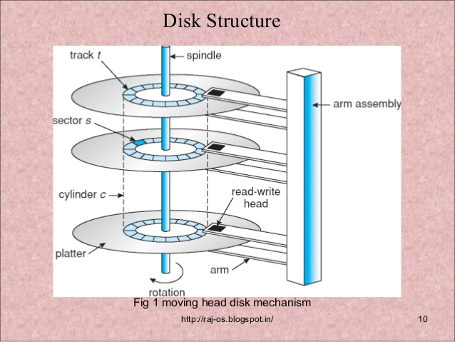

Slide 8
File System Layers
Device drivers manage I/O devices at the I/O control layer
  Given commands like “read drive1, cylinder 72, track 2, sector 10, into memory location 1060” outputs low-level hardware specific commands to hardware controller
Basic file system given command like “retrieve block 123” translates to device driver
Also manages memory buffers and caches (allocation, freeing, replacement)
  Buffers hold data in transit
  Caches hold frequently used data
File organization module understands files, logical address, and physical blocks
  Translates logical block # to physical block #
  Manages free space, disk allocation

Slide 9
File System Layers (Cont.)
Logical file system manages metadata information
  Translates file name into file number, file handle, location by maintaining file control blocks (inodes in UNIX)
  Directory management
  Protection
Layering useful for reducing complexity and redundancy, but adds overhead and can decrease performanceTranslates file name into file number, file handle, location by maintaining file control blocks (inodes in UNIX)
  Logical layers can be implemented by any coding method according to OS designer

Slide 10
File System Layers (Cont.)
Many file systems, sometimes many within an operating system
  Each with its own format (CD-ROM is ISO 9660; Unix has UFS, FFS; Windows has FAT, FAT32, NTFS as well as floppy, CD, DVD Blu-ray, Linux has more than 40 types, with extended file system ext2 and ext3 leading; plus distributed file systems, etc.)
  New ones still arriving – ZFS, GoogleFS, Oracle ASM, FUSE

Slide 11
Allocation Methods - Contiguous
An allocation method refers to how disk blocks are allocated for files.
Three major methods of allocating disk space are in wide use: contiguous, linked, and indexed. Each method has advantages and disadvantages.
Contiguous allocation – each file occupies set of contiguous blocks
  Best performance in most cases
  Simple – only starting location (block #) and length (number of blocks) are required
  Problems include finding space for file, knowing file size, external fragmentation, need for compaction off-line (downtime) or on-line

Slide 12

Contiguous Allocation
Contiguous allocation of a file is defined by the disk address and length (in block units) of the first block.
If the file is n blocks long and starts at location b, then it occupies blocks b, b + 1, b + 2, ..., b + n − 1.
The directory entry for each file indicates the address of the starting block and the length of the area allocated for this file (Figure).

Slide 13
Extent-Based Systems
Many newer file systems (i.e., Veritas File System) use a modified contiguous allocation scheme
Extent-based file systems allocate disk blocks in extents
An extent is a contiguous block of disks
  Extents are allocated for file allocation
  A file consists of one or more extents
Here, a contiguous chunk of space is allocated initially. Then, if that amount proves not to be large enough, another chunk of contiguous space, known as an extent, is added.
The location of a file’s blocks is then recorded as a location and a block count, plus a link to the first block of the next extent.

Slide 14
Allocation Methods - Linked
Linked allocation solves all problems of contiguous allocation. With linked allocation, each file is a linked list of disk blocks; the disk blocks may be scattered anywhere on the disk. The
The directory contains a pointer to the first and last blocks of the file.
For example, a file of five blocks might start at block 9 and continue at block 16, then block 1, then block 10, and finally block 25 (Figure). Each block contains a pointer to the next block.
To create a new file, we simply create a new entry in the directory. With linked allocation, each directory entry has a pointer to the first disk block of the file.

Slide 15

Linked Allocation

Slide 16
Allocation Methods - Linked
  File ends at nil pointer
  No external fragmentation
  Each block contains pointer to next block
  No compaction, external fragmentation
  Free space management system called when new block needed
  Improve efficiency by clustering blocks into groups but increases internal fragmentation
  Reliability can be a problem
  Locating a block can take many I/Os and disk seeks
  Another disadvantage is the space required for the pointers. If a pointer requires 4 bytes out of a 512-byte block, then 0.78 percent of the disk is being used for pointers, rather than for information.

Slide 17
Allocation Methods - Indexed
Linked allocation cannot support efficient direct access, since the pointers to the blocks are scattered with the blocks themselves all over the disk and must be retrieved in order.
Indexed allocation solves this problem by bringing all the pointers together into one location: the index block.
  Each file has its own index block(s) of pointers to its data blocks
Indexed allocation supports direct access, without suffering from external fragmentation, because any free block on the disk can satisfy a request for more space. Indexed allocation does suffer from wasted space, however.

Slide 18

Example of Indexed Allocation

Slide 19
Indexed Allocation (Cont.)
Need index table
Random access
Dynamic access without external fragmentation, but have overhead of index block

Slide 20
Free-Space Management
Since disk space is limited, we need to reuse the space from deleted files for new files, if possible.
To keep track of free disk space, the system maintains a free-space list.
The free-space list records all free disk blocks—those not allocated to some file or directory.
To create a file, we search the free-space list for the required amount of space and allocate that space to the new file. This space is then removed from the free-space list.
When a file is deleted, its disk space is added to the free-space list.

Slide 21
Free-Space Management (contd.)
Bit vector or bit map
Frequently, the free-space list is implemented as a bit map or bit vector. Each block is represented by 1 bit. If the block is free, the bit is 1; if the block is allocated, the bit is 0.
For example, consider a disk where blocks 2, 3, 4, 5, 8, 9, 10, 11, 12, 13, 17, 18, 25, 26, and 27 are free and the rest of the blocks are allocated. The free-space bit map would be
001111001111110001100000011100000 ...
The main advantage of this approach is its relative simplicity and its efficiency in finding the first free block or n consecutive free blocks on the disk.

Slide 22
Free-Space Management (Contd.)
File system maintains free-space list to track available blocks/clusters
  (Using term “block” for simplicity)
Bit vector or bit map (n blocks)
0
1
2
n-1
…
1 ⇒ block[i] free
0 ⇒ block[i] occupied
bit[i] =

Block number calculation
(number of bits per word) * (number of 0-value words) + offset of first 1 bit
CPUs have instructions to return offset within word of first “1” bit

Slide 23
Free-Space Management (Cont.)
Bit map requires extra space
  Example:
block size = 4KB = 2¹² bytes
disk size = 2⁴⁰ bytes (1 terabyte)
n = 2⁴⁰/2¹² = 2²⁸ bits (or 32MB)
if clusters of 4 blocks -> 8MB of memory
Easy to get contiguous files

Slide 24
Free-Space Management (Contd.)
Linked List
Another approach to free-space management is to link together all the free disk blocks, keeping a pointer to the first free block in a special location on the disk and caching it in memory.
This first block contains a pointer to the next free disk block, and so on. Recall our earlier example, in which blocks 2, 3, 4, 5, 8, 9, 10, 11, 12, 13, 17, 18, 25, 26, and 27 were free and the rest of the blocks were allocated.
In this situation, we would keep a pointer to block 2 as the first free block. Block 2 would contain a pointer to block 3, which would point to block 4, which would point to block 5, which would point to block 8, and so on (Figure).

Slide 25

Linked Free Space List on Disk
Linked list (free list)
  Cannot get contiguous space easily
  No waste of space
  No need to traverse the entire list (if # free blocks recorded)

Slide 26
Free-Space Management (Cont.)
Grouping
  Modify linked list to store address of next n-1 free blocks in first free block, plus a pointer to next block that contains free-block-pointers (like this one)
Counting
  Because space is frequently contiguously used and freed, with contiguous-allocation allocation, extents, or clustering
    Keep address of first free block and count of following free blocks
    Free space list then has entries containing addresses and counts

Slide 27
Directory Structure
A collection of nodes containing information about all files
Directory
Files
F 1
F 2
F 3
F 4
F n
Both the directory structure and the files reside on disk

Slide 28

Single-Level Directory
A single directory for all users
Naming problem
Grouping problem

Slide 29

Two-Level Directory
Separate directory for each user
Path name
Can have the same file name for different user
Efficient searching
No grouping capability

Slide 30

Tree-Structured Directories

